Slide 1


AIRBNB CHICAGO
PRICE PREDICTION
Group 18
Jai Agrawal, Yaohui Wu, Jennie Ryu, Xiaofan Zhu, Sahithi Muddana

Slide 2
CONTENTS OF THE REPORT
01
INTRODUCTION
02
ANALYSIS
03
CONCLUSION
Market Analysis
Data Overview
Data Cleaning
& Data Preprocessing
Before Preprocessing
After Preprocessing
Key Takeaways
Conclusion
Group 18

Slide 3




MARKET ANALYSIS
5.6M+
4M+
$110B+
220+
Group 18

Slide 4

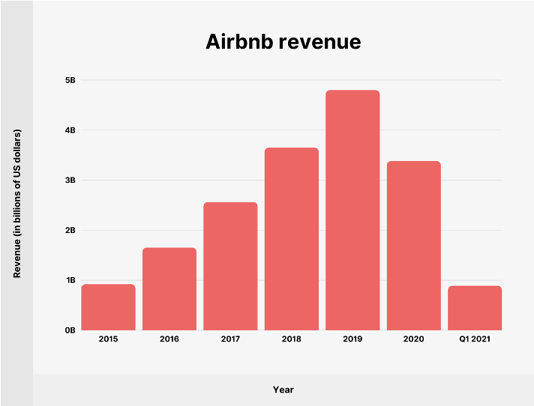
MARKET ANALYSIS
Group 18

Slide 5


MARKET ANALYSIS
ECONOMY
LUXURY
Below $126
Above $126
Group 18

Slide 6
DATA OVERVIEW
36
6,529
LISTING
FEATURES
302,750
REVIEWS
Group 18

Slide 7
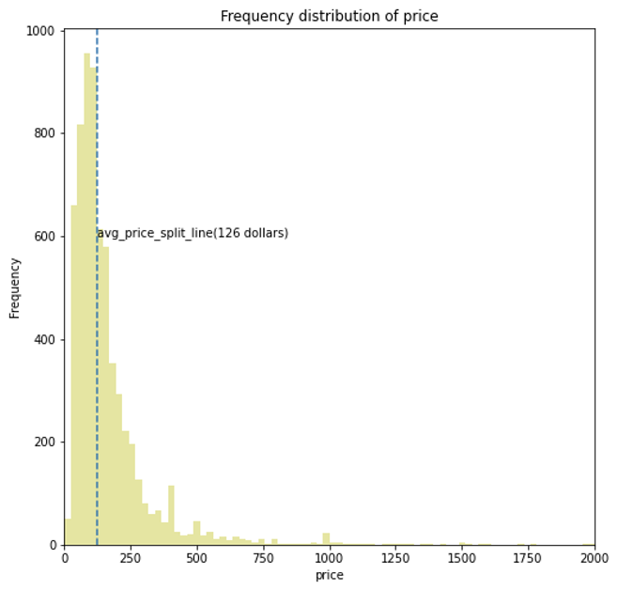
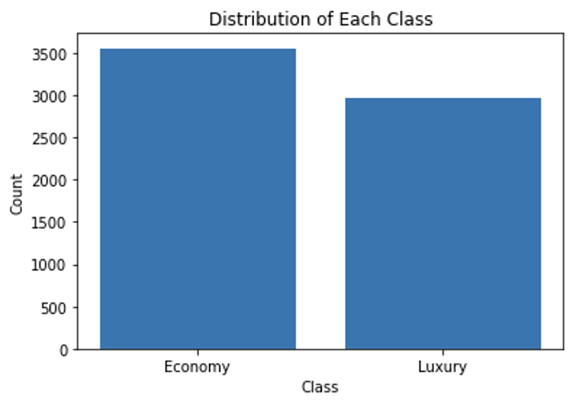
DATA VISUALIZATIONS
Group 18

Slide 8
DATA CLEANING & PREPROCESSING
CREATED
REPLACED
TURNED
RAN
classification variable using the "Price" feature
NA values with averages grouped by "Neighborhood" features
categorical variables into numeric data
sentiment analysis on text to convert it into numeric data
Group 18

Slide 9
MODELS
Logistic Regression
Decision Tree
Random Forest
K-nearest Neighbors
Group 18

Slide 10
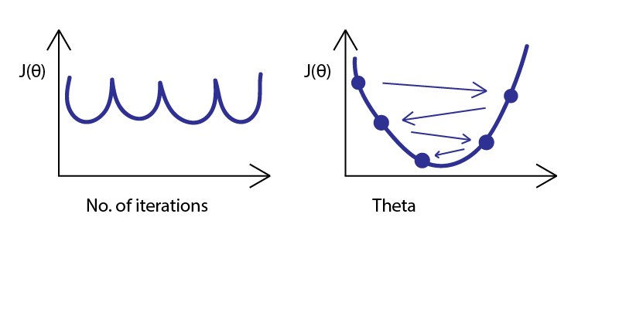
LOGISTIC REGRESSION
Iteration
Innerworkings
Group 18

Slide 11
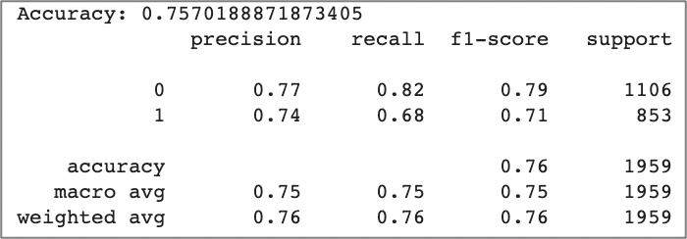
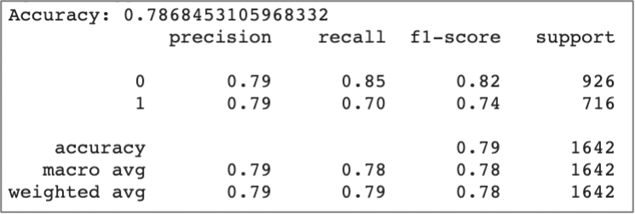
LOGISTIC REGRESSION
After
Pre-Processing
Benchmark
Accuracy : 0.76
F1-Score : 0.76
AUC : 0.85
Accuracy : 0.79
F1-Score : 0.78
AUC : 0.87
Group 18

Slide 12
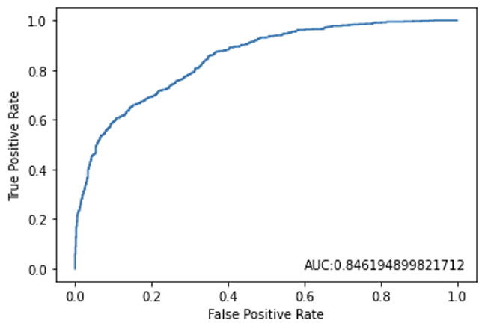
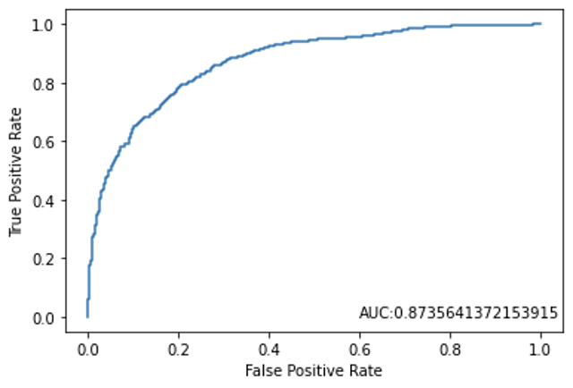
LOGISTIC REGRESSION
After
Pre-Processing
Benchmark
Group 18

Slide 13
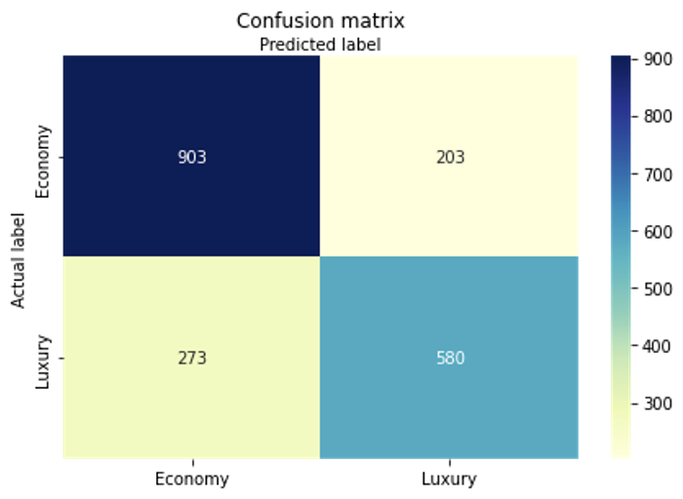
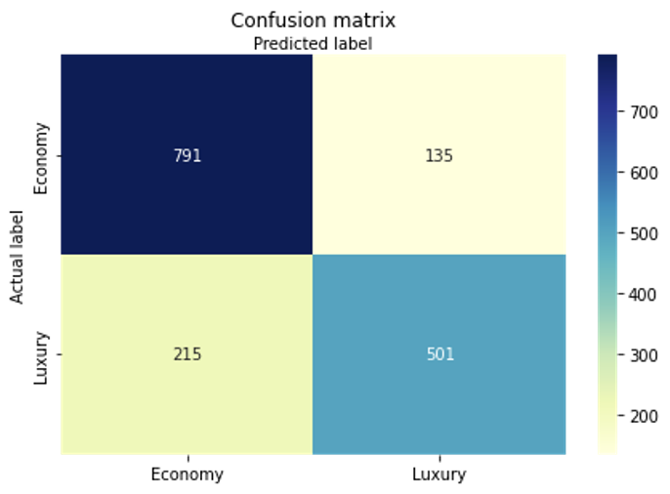
LOGISTIC REGRESSION
After
Pre-Processing
Benchmark
Group 18

Slide 14
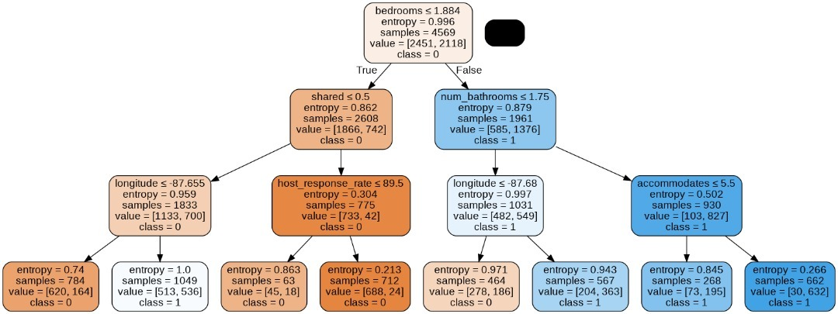
DECISION TREE
Group 18

Slide 15
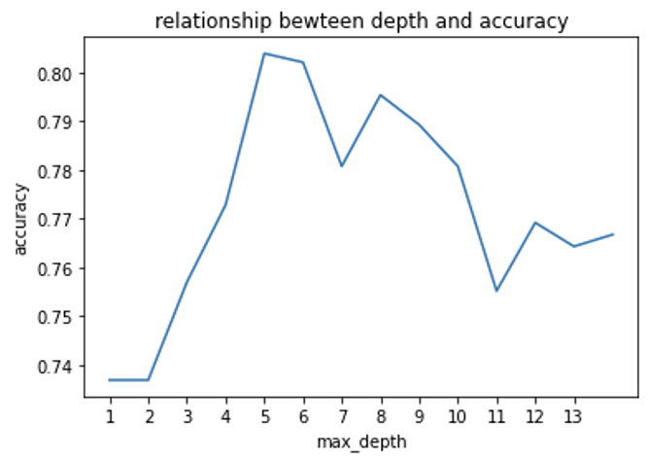
DECISION TREE
Depth vs. Accuracy
Optimal Depth : 5
Group 18

Slide 16
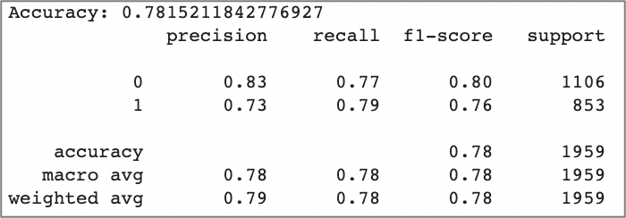
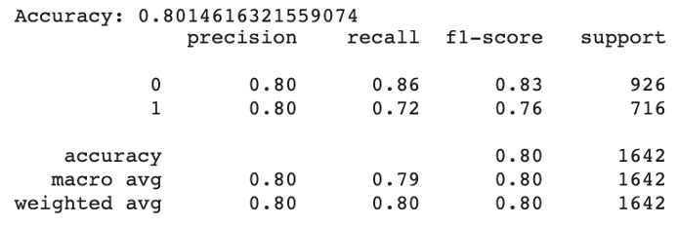
DECISION TREE
After
Pre-Processing
Benchmark
Accuracy : 0.78
F1-Score : 0.78
AUC : 0.86
Accuracy : 0.79
F1-Score : 0.80
AUC : 0.87
Group 18

Slide 17
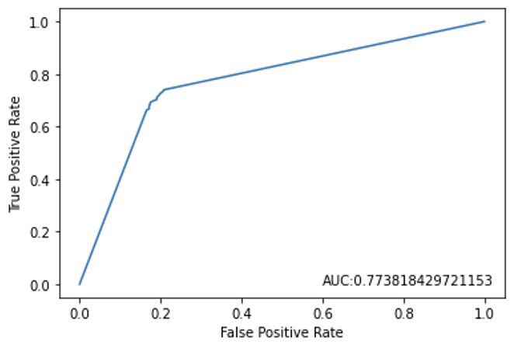
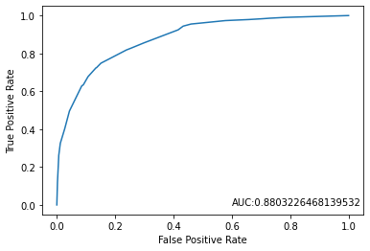
DECISION TREE
After
Pre-Processing
Benchmark
Group 18

Slide 18
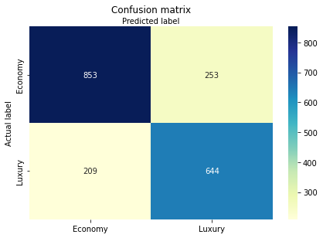
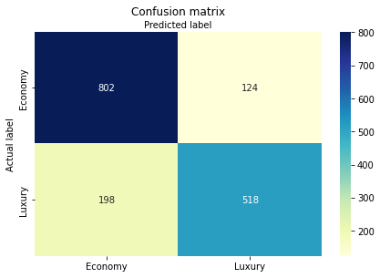
DECISION TREE
After
Pre-Processing
Benchmark
Group 18

Slide 19
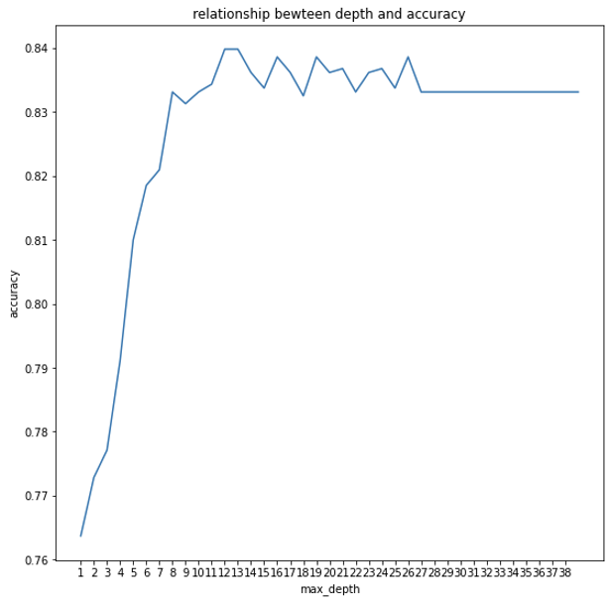
RANDOM FOREST
Depth vs. Accuracy
Optimal Depth : 12
Group 18

Slide 20
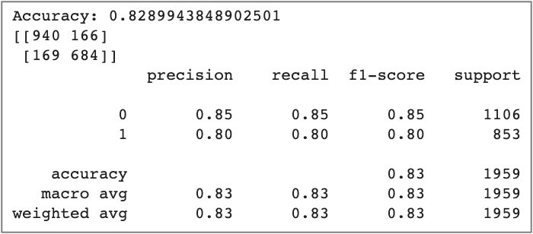
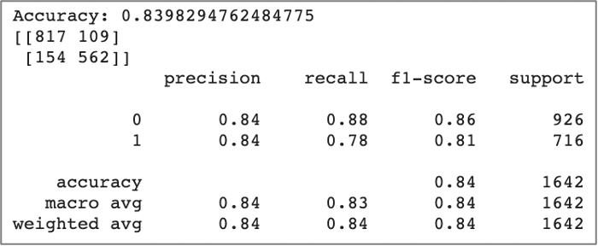
RANDOM FOREST
After
Pre-Processing
Benchmark
Accuracy : 0.79
F1-Score : 0.79
AUC : 0.88
Accuracy : 0.82
F1-Score : 0.82
AUC : 0.90
Group 18

Slide 21
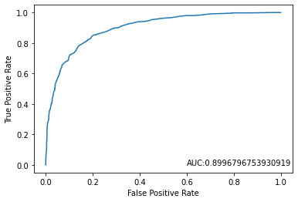
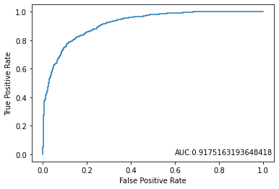
RANDOM FOREST
After
Pre-Processing
Benchmark
Group 18

Slide 22
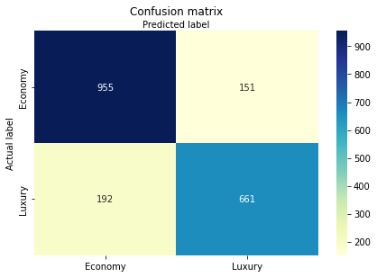

RANDOM FOREST
After
Pre-Processing
Benchmark
Group 18

Slide 23
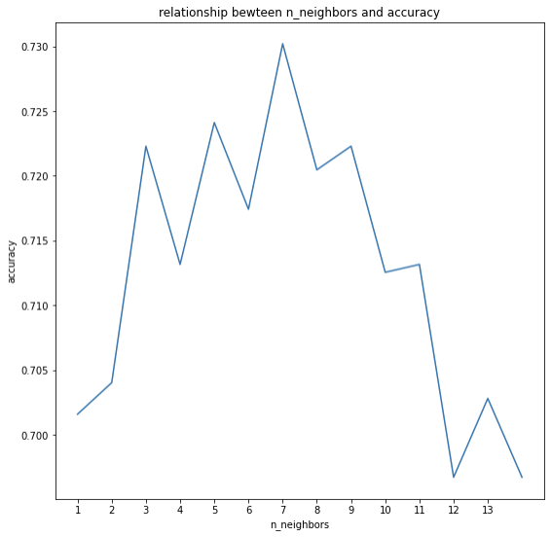
K-NEAREST NEIGHBORS
Depth vs. Accuracy
Optimal K : 7
Group 18

Slide 24
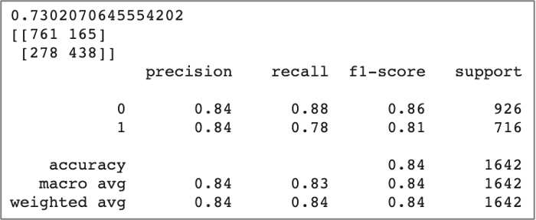
K-NEAREST NEIGHBORS
After
Pre-Processing
Benchmark
Accuracy : 0.68
F1-Score : 0.69
AUC : 0.73
Accuracy : 0.72
F1-Score : 0.82
AUC : 0.78
Group 18

Slide 25
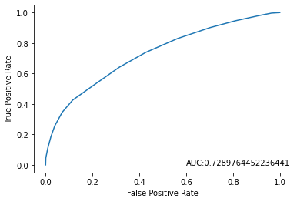
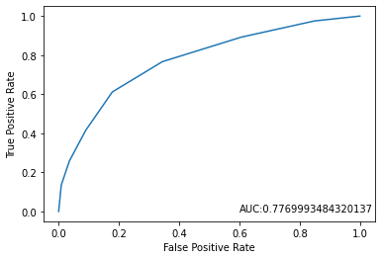
K-NEAREST NEIGHBORS
After
Pre-Processing
Benchmark
Group 18

Slide 26
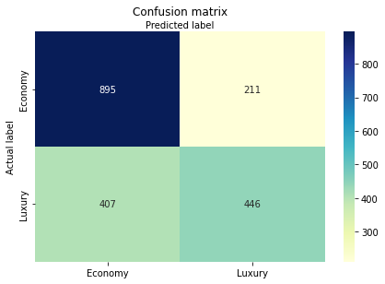
K-NEAREST NEIGHBORS
After
Pre-Processing
Benchmark
Group 18

Slide 27
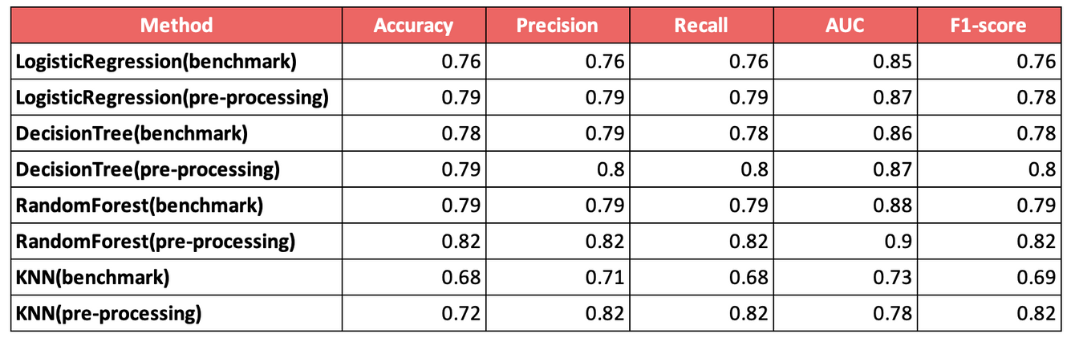
KEY TAKEAWAYS
1
2
3
4
Random
Forest
Decision
Tree
Logistic
Regression
K-nearest
Neighbors
Group 18

Slide 28
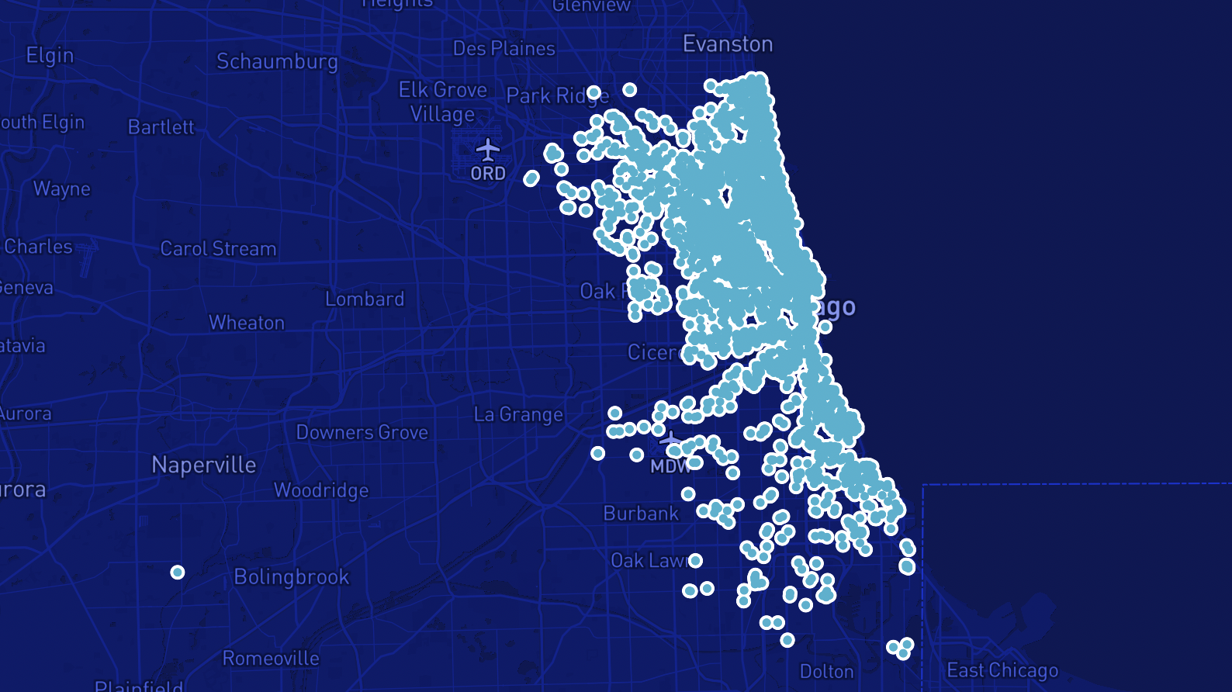
CONCLUSION

Slide 29

Q&A

